Slide 1
Binomial Distribution & Maximum Likelihood Estimation

Slide 2

Binomial Distribution

Slide 3
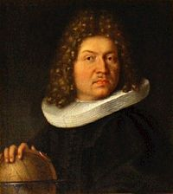
Bernoulli Trials
Single events with 2 possible outcomes
Coin flip
Live/dead
Parameter
p = probability of success
Jacob Bernoulli

Slide 4
Binomial Distribution
Two parameters:
The number of independent Bernoulli trials, n
The probability of ‘success’ for each trial, p
Random variable, y = number of ‘successes’
y ~Bin(n,p)

Slide 5
The Binomial Distribution (a sum of n independent Bernoulli trials)
Suppose I flip a coin 11 times (n =11) and the probability of a heads with a weighted coin is p = 0.70. What is the probability of getting 9 heads?

Slide 6
Binomial Variance
Variance is a function of the parameter and number of trials

Slide 7
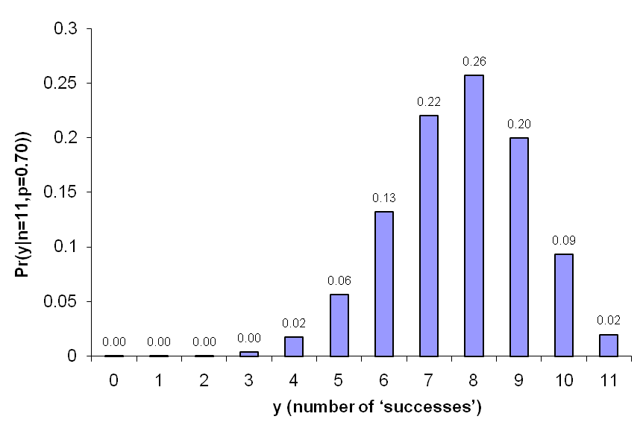
Binomial Distribution
This is a probability density function (pdf):
Given p, which outcome is most likely?

Slide 8
Binomial Distribution
What if p is not known?
How would we determine p?
Why should we use that method?

Slide 9
Maximum Likelihood Estimation

Slide 10
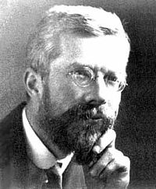
Maximum Likelihood Estimation
The fundamental basis for estimation (and most of statistics)
Developed by Sir Ronald Fisher
At age 22 while an undergrad!!
Likelihood Principle states that ALL of the information in a sample is contained in the likelihood function

Slide 11
Likelihood Function
Likelihood of the parameters conditional on the observed data (and the model)

Slide 12
Binomial Likelihood Function
Likelihood of p given y successes and n trials

Slide 13
Example
y = 7 successes
n = 10 trials

Slide 14
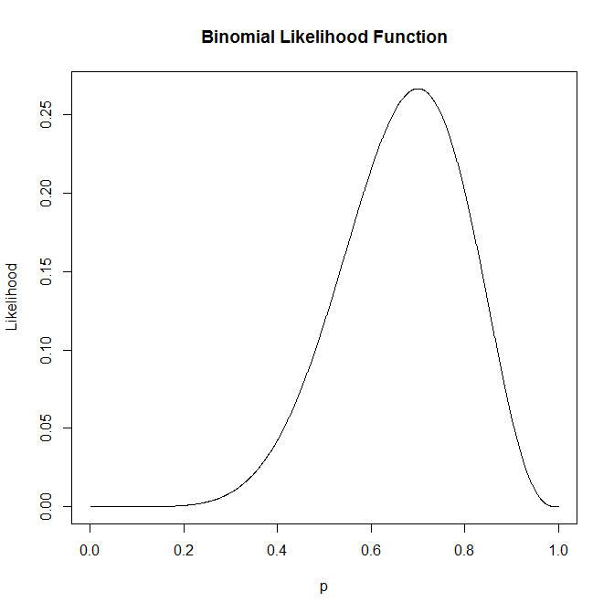
Binomial Likelihood Function

Slide 15
Binomial Likelihood Function
Which value of p is most likely given the data?

Slide 16
Binomial Likelihood Function
Which value of p is most likely given the data?

Slide 17
Binomial Likelihood Function
What is in general?

Slide 18
Binomial Likelihood Function
What is in general?
Solve for p that maximizes L(p|y,n)
But, how???

Slide 19
Log-likelihood functions
Bernoulli discovered ‘e’ as well!
The natural log of the likelihood function provides lots of “nice” features

Slide 20
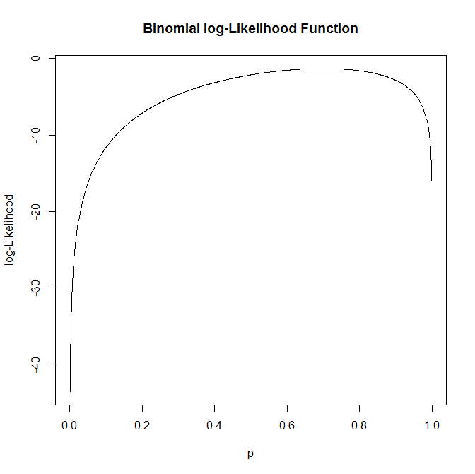
Binomial log-Likelihood Function

Slide 21
Binomial log-Likelihood Function
Which value of p is most likely given the data?

Slide 22
Binomial log-Likelihood Function
Which value of p is most likely given the data?

Slide 23
Finding maxima
What are the mathematical properties of the maximum of a function?

Slide 24
Finding maxima
What are the mathematical properties of the maximum of a function?
1st derivative = 0
2nd derivative < 0
How does this help us?

Slide 25
Binomial Log-Likelihood
Take the 1st derivative of the log-likelihood function

Slide 26
Binomial Log-Likelihood
Take the 1st derivative of the log-likelihood function
Set the result equal to zero

Slide 27
Binomial Log-Likelihood
Set the result equal to zero
Solve for p
Notes:
Multiply by (1-p). Then 0=((1-p)/p)*y+(n-y). Then n-y = ((1-p)/p)*y; then (n/y)-1=1/p -1

Slide 28
Binomial Log-Likelihood
Set the result equal to zero
Solve for p
A lot of work for an obvious solution! So…

Slide 29
If there is >1 parameter
You could…
Calculate derivatives with respect to each parameter
Set all of the derivatives = 0
Solve the system of equation

Slide 30
If there is >1 parameter
You could…
Calculate derivatives with respect to each parameter
Set all of the derivatives = 0
Solve the system of equation
This would work if…
You’re really good at calculus & algebra
A closed-form solution exists

Slide 31
If there is >1 parameter
Otherwise, …
Use numerical optimization on a computer

Slide 32
Log-Likelihood and variance
Shape of log-L function determines precision
Information matrix I(Θ)
Matrix of mixed 2nd order partial derivatives of the log-likelihood function
Variance = -I(Θ)⁻¹

Slide 33
Key Properties of MLE’s
Asymptotically unbiased

Slide 34
Key Properties of MLE’s
Asymptotically unbiased
Asymptotically normally distributed

Slide 35
Key Properties of MLE’s
Asymptotically unbiased
Asymptotically normally distributed
Asymptotically Uniformly Minimum Variance among Unbiased Estimators

Slide 36
Key Properties of MLE’s
Asymptotically unbiased
Asymptotically normally distributed
Asymptotically Uniformly Minimum Variance among Unbiased Estimators
1:1 transformations of MLE’s are also MLE’s

Slide 37
Poisson Example

Slide 38
Poisson Example
Solution by hand

Slide 39
Solution in R
poisson.ll<- function( lam, x ){
#
# Poisson likelihood function
#
logL <- sum(-lam+x*log(lam))
return( logL )
}
x <- rpois( 100, 10 ) # generate some data
b <- 8 # initial value for lambda
res <- optim( b, poisson.ll, control=options(list(fnscale=-1)), hessian=T, x=x ) # maximize the likelihood

